Slide 1

E-commerce Order Tracking and Customer Analytics System
Team Members:
Divya Sree Kuntamalla
Sriram Chunduri
Group Number: Group 20
Presentation Date: 12-13-2024

Slide 2
Project Framing and Explanation
Problem Statement:
Managing customer orders, inventory levels, payments, and customer behavior is complex in e-commerce.
Issues like overstocking, stockouts, delayed shipping, and lack of customer insights can lead to poor service and lost sales.
Proposed Solution:
An integrated database system for:
Order Tracking
Customer Management
Inventory Monitoring
Payment Processing and Shipment Tracking
Review Management
Outcome:
Streamlined operations, improved customer satisfaction, and data-driven decision-making.

Slide 3
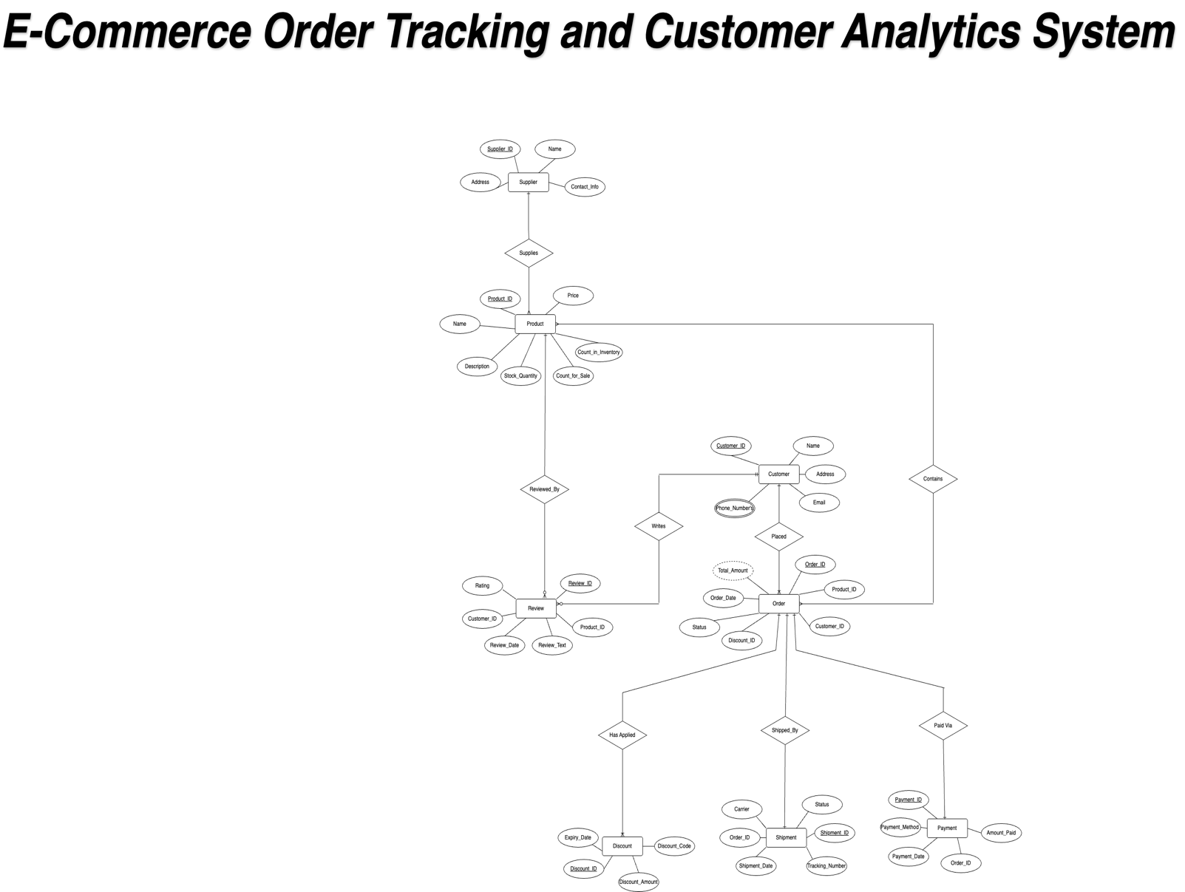


Slide 4
Entity-Relationship Diagram (ERD)
ER Diagram with key entities and relationships:
Entities:
Customer, Order, Product, Supplier, Shipment, Payment, Review, Discount
Relationships:
Customers place multiple orders.
Orders include products.
Products are supplied by suppliers.
Orders have payments and shipments.
Customers write reviews for products.
Discounts are applied to orders.

Slide 5
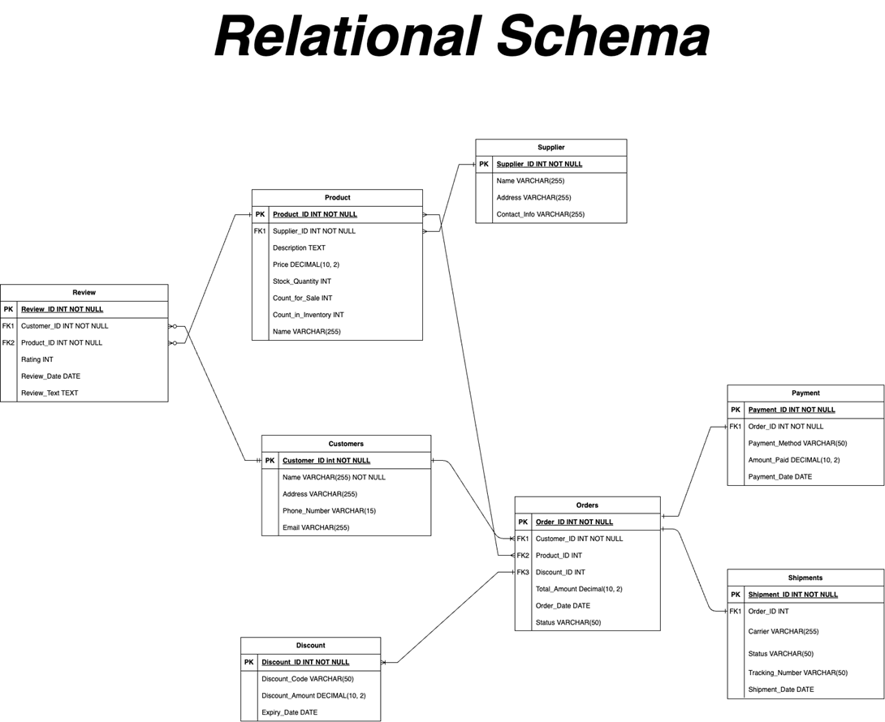

Slide 6
Data Sources
Data Used:
Suppliers Data: Generated manually with fictitious supplier details.
Products Data: Includes product names, descriptions, prices, and stock quantities.
Customers Data: Created using a random customer data generator.
Orders Data: Manually created orders with associated products and customers.
Payments, Shipments, Reviews, Discounts: Fictitious data created to simulate real-world transactions.

Slide 7
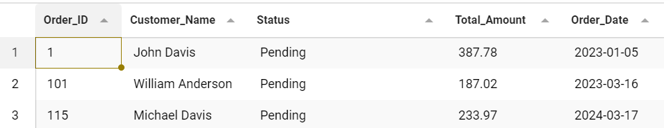
Query 1 - Pending or Cancelled Orders
Purpose: Retrieves pending or canceled orders to help track unresolved transactions.
SQL Query:
SELECT
o.Order_ID,
c.Name AS Customer_Name,
o.Status,
o.Total_Amount,
o.Order_Date
FROM Orders o
JOIN Customers c ON o.Customer_ID = c.Customer_ID
WHERE o.Status IN ('Pending', 'Cancelled’);
Explanation:
This query helps businesses identify orders that are not yet resolved. Managers can follow up on pending orders to ensure timely processing and investigate canceled orders to understand why they were not fulfilled.

Slide 8
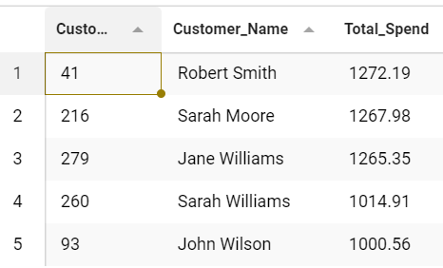
Query 2 - Top 5 Customers by Total Spend
Purpose: Identify high-value customers.
SQL Query:
SELECT
c.Customer_ID,
c.Name AS Customer_Name,
SUM(o.Total_Amount) AS Total_Spend
FROM Customers c
JOIN Orders o ON c.Customer_ID = o.Customer_ID
GROUP BY c.Customer_ID, c.Name
ORDER BY Total_Spend DESC
LIMIT 5;
Explanation:
Identifies the highest-spending customers, helping to prioritize customer engagement and loyalty programs.

Slide 9
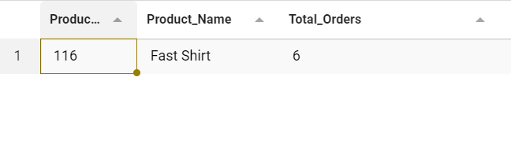
QUERY 3 - Most Popular Product Based on Orders
Purpose: Determines the most frequently ordered product.
SQL Query:
SELECT
p.Product_ID,
p.Name AS Product_Name,
COUNT(o.Order_ID) AS Total_Orders
FROM Products p
JOIN Orders o ON p.Product_ID = o.Product_ID
GROUP BY p.Product_ID, p.Name
ORDER BY Total_Orders DESC
LIMIT 1;
Explanation:
Identifying the most popular product helps businesses ensure they have sufficient stock to meet demand and focus their marketing efforts on high-demand items.

Slide 10
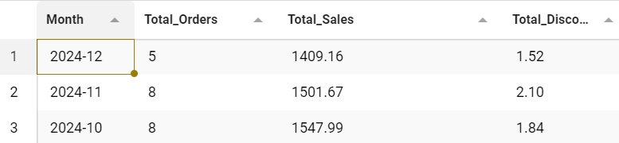
Query 4 - Monthly Sales Analysis with Discount Impact
Purpose: Analyzes monthly sales, including the impact of discounts
SQL Query:
SELECT
DATE_FORMAT(o.Order_Date, '%Y-%m') AS Month,
COUNT(o.Order_ID) AS Total_Orders,
SUM(o.Total_Amount) AS Total_Sales,
SUM(IFNULL(d.Discount_Amount, 0)) AS Total_Discount
FROM Orders o
LEFT JOIN Discounts d ON o.Discount_ID = d.Discount_ID
GROUP BY Month
ORDER BY Month DESC;
Explanation:
Shows monthly sales trends and how discounts affect overall sales.

Slide 11
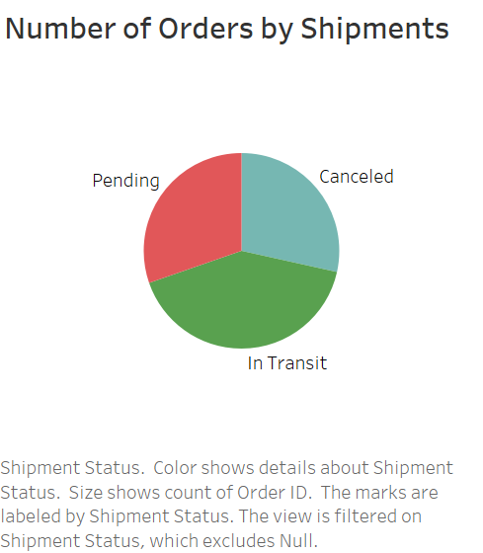
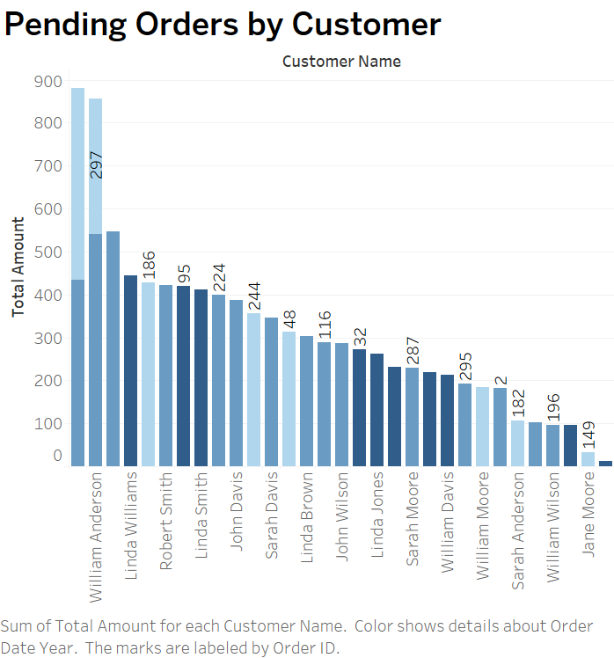

Slide 12
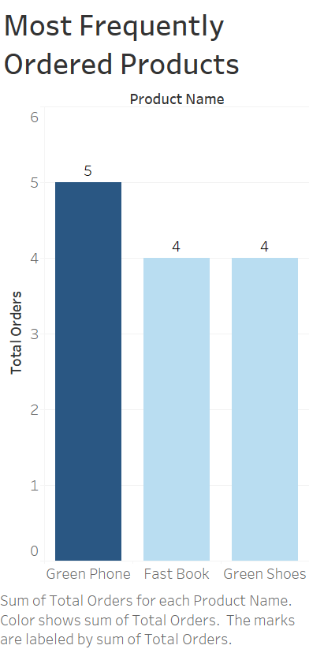
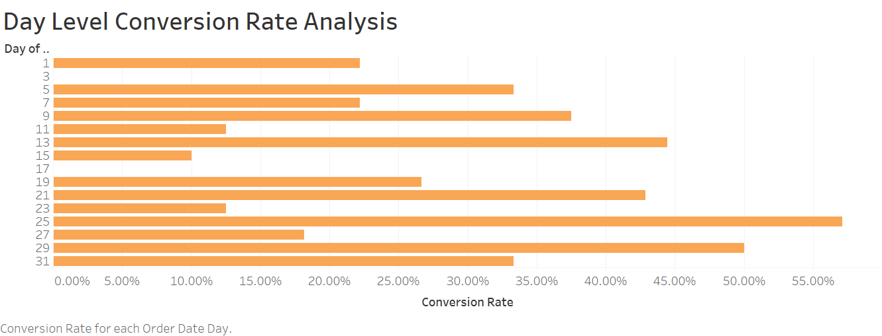
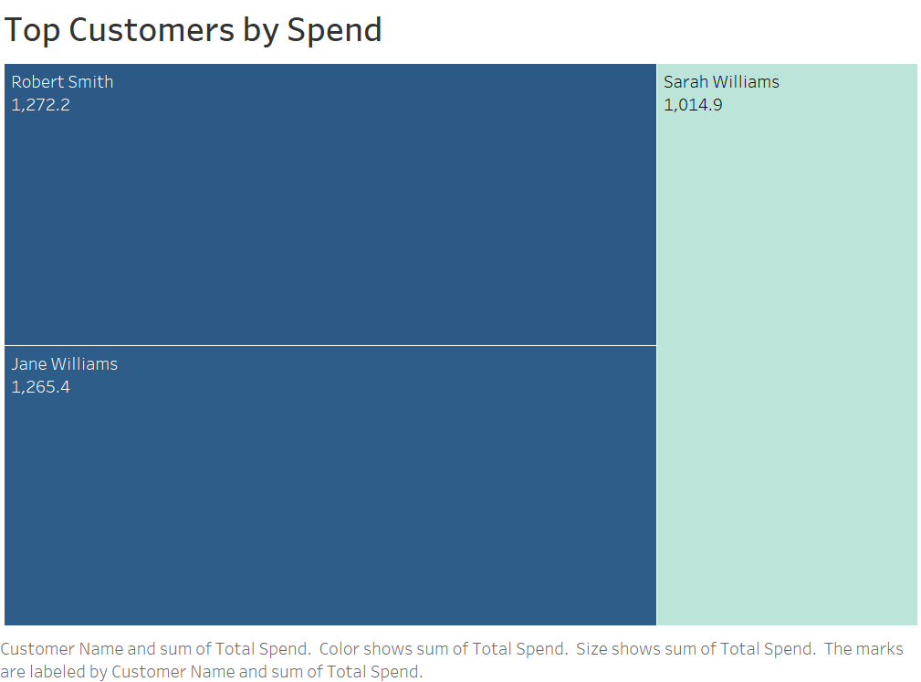

Slide 13
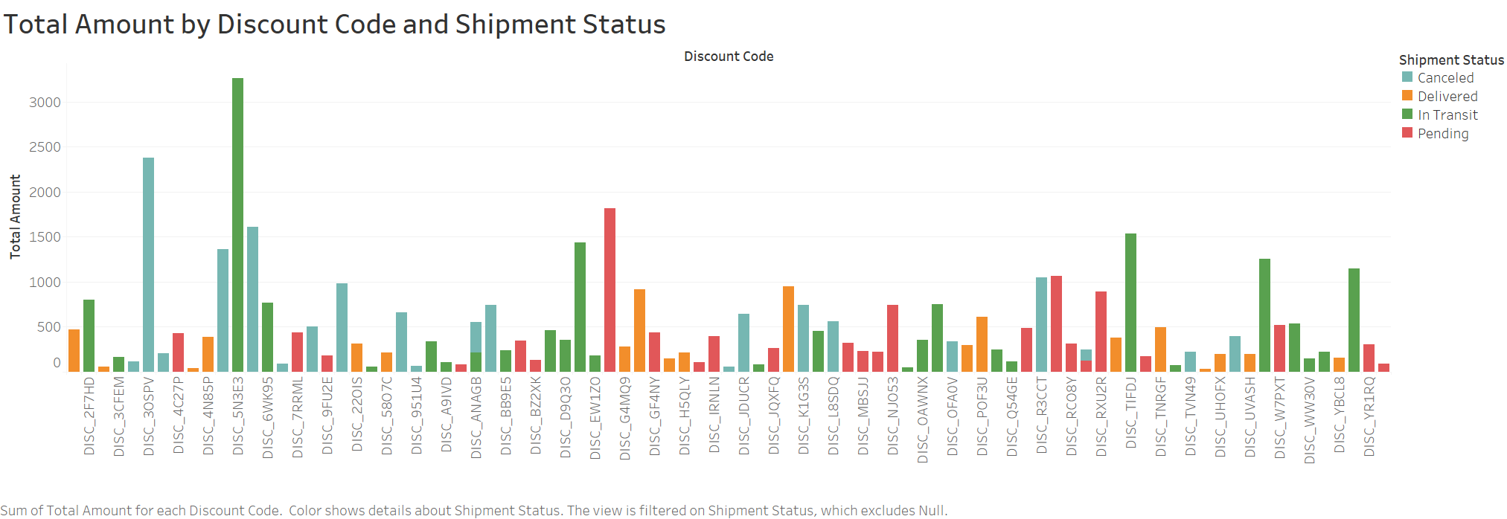

Slide 14
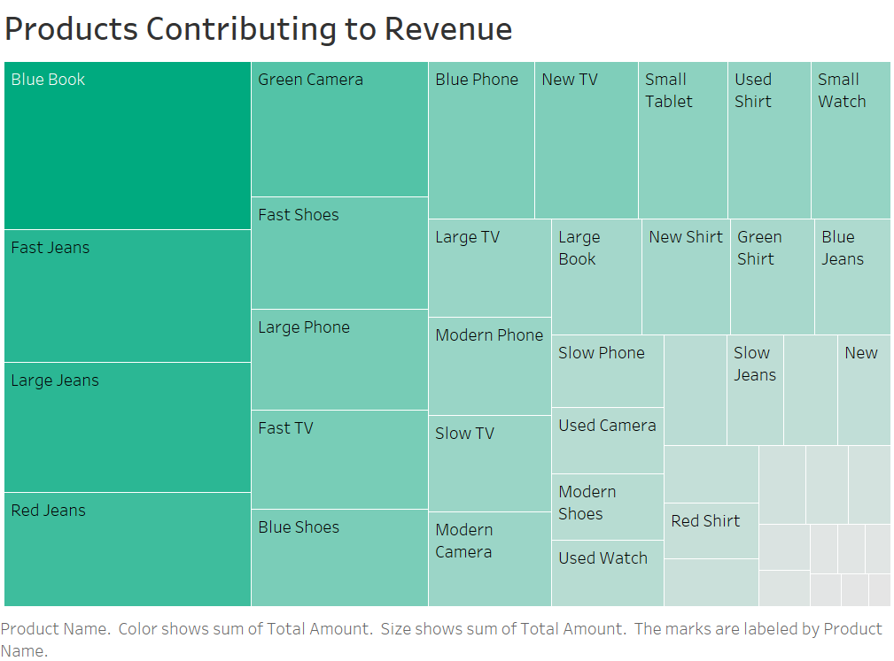

Slide 15
Conclusion
Summary:
The integrated database system effectively manages orders, inventory, and customer data.
SQL queries provide insights into business performance.
Visualizations aid in data-driven decision-making.
Future Improvements:
Implement real-time dashboards.
Enhance system scalability for larger datasets.

Slide 16

THANK YOU

